Slide 1


Clinical Problem Solving
Fateme Azizi, MD
CARDIOLOGY RESIDENT
June 2026

Slide 2
Step 1

Slide 3
Chief Complaint
75-year-old man
Decreased level of consciousness

Slide 4
Present illness
A 75-year-old man with no known chronic medical illness was brought to the emergency department because of progressive decline in the level of consciousness over the preceding 2 days. According to his family, he gradually became unresponsive to verbal stimuli.
Ten days before admission, he had developed progressive generalized weakness and fatigue
accompanied by reduced appetite , decreased urine output , intermittent productive cough, dyspnea, and occasional nausea and vomiting.

Slide 5
Present illness
According to his family, there was no history of fever, chills, night sweats, chest pain, orthopnea, paroxysmal nocturnal dyspnea, or other urinary symptoms apart from decreased urine output.
His symptoms had initially started approximately four months earlier following an episode of acute respiratory tract infection, after which he experienced persistent fatigue, anorexia, and an unintentional weight loss of approximately 10 kg.

Slide 6
Present illness
He also had a history of intermittent constipation for several years.
One month before the current admission, he was hospitalized because of generalized weakness and bilateral lower-extremity edema and was discharged after partial clinical improvement. Approximately two weeks later, he required rehospitalization because of recurrent symptoms. During that admission, he developed severe acute kidney injury requiring initiation of hemodialysis.

Slide 7
Present illness
Notably, his serum creatinine had been approximately 1 mg/dL two months before
the current illness. Following discharge, he continued outpatient hemodialysis. However, about one week later, his weakness and anorexia progressively worsened and were accompanied by impaired speech and progressive decline in the level of consciousness, prompting the current admission.

Slide 8
history
Past Medical History: recent dialysis-dependent AKI , IHD?
Past Surgical History : Unremarkable
Allergy History :No known drug allergies.
Family History : Unremarkable

Slide 9
history
Social History : Unremarkable.
No smoking, alcohol consumption, and illicit drug use
Drug History:
ASA 80 DAILY
BISOPROLOL 2.5 DAILY
ALLOPURINOL 100 DAILY
PANTOPRAZOLE 40 DAILY

Slide 10
Physical Examination
General Appearance :
Ill-appearing elderly man
GCS: 10/15
Vital Signs:
Blood pressure:135/80 mmHg
Heart rate: 90 beats per minute
Respiratory rate: 28 breaths per minute
Temperature: 37.3 °C
Oxygen saturation: 91% on room air

Slide 11
Physical Examination
No skin rash or other cutaneous lesions
Head & Neck
Pale conjunctiva
No scleral icterus
Pupils equal, round, and reactive to light
JVP was not assessed

Slide 12
Physical Examination
Chest:
Bilateral generalized rhonchi
Decreased breath sounds at both lung bases
Cardiovascular:
Regular heart rhythm
No murmur, gallop, or pericardial rub
Abdomen:
Mild abdominal distension
No organomegaly
No tenderness or guarding

Slide 13
Physical Examination
Extremities:
Bilateral symmetric pitting edema
Peripheral pulses palpable
Neurologic:
No focal neurologic deficit
Normal muscle tone
Preserved motor strength in all four extremities

Slide 14
Problem List
Decreased level of consciousness (GCS 10/15)
Severe AKI
anorexia /Poor oral intake
productive cough /Dyspnea
Weakness/fatigue
Significant weight loss
Constipation
Decreased urine output

Slide 15
step 2

Slide 16
Initial Laboratory Findings
Writing
WBC | 16900 | segment | 85
HB | 8.7 | MCV | 87
PLT | 116000 | AST | 65
BUN | 57 | ALT | 20
Cr | 7.3 | ALK | 308
Na | 132 | Bili T | 1.3
K | 4.6 | Bili D | 0.3
Ca | 7.1 | Alb | 1.7
P | 7 | LDH | 505
Uric acid | 8.2 | BS | 66
mg | 1.9 | ESR | 50
Total pro | 4.6 | CRP | 189

Slide 17
Initial Laboratory Findings
Writing
VBG |  | UA
PH | 7.46 | WBC | 10 -15
PCO2 | 25 | RBC | 2-3
HCO3 | 18 | PRO | Weakly positive
UC
10000 | Mix urogenital flora
PT | 20
INR | 1.63
PTT | 55

Slide 18
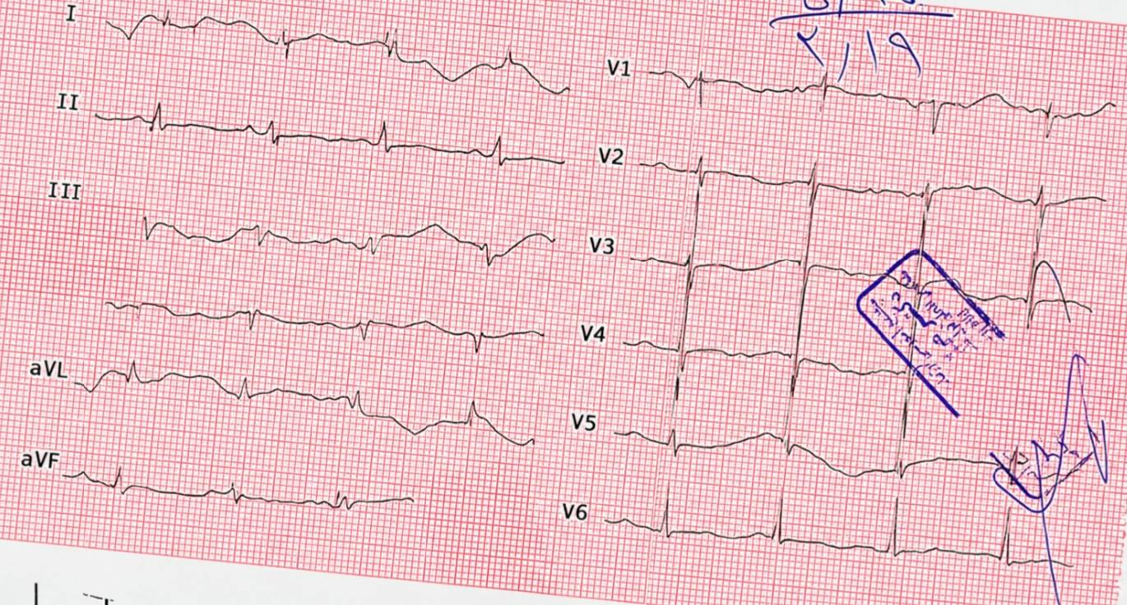
Initial ECG

Slide 19
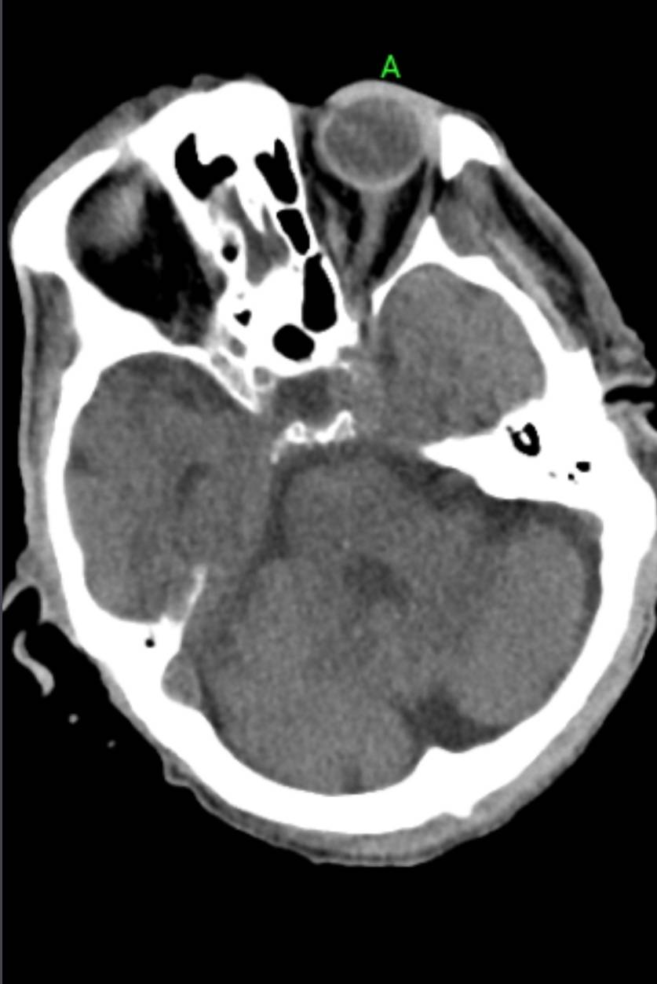
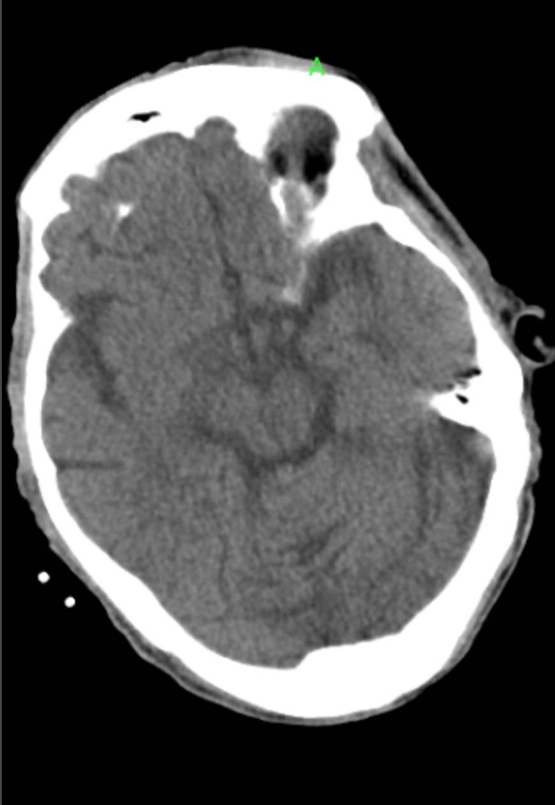
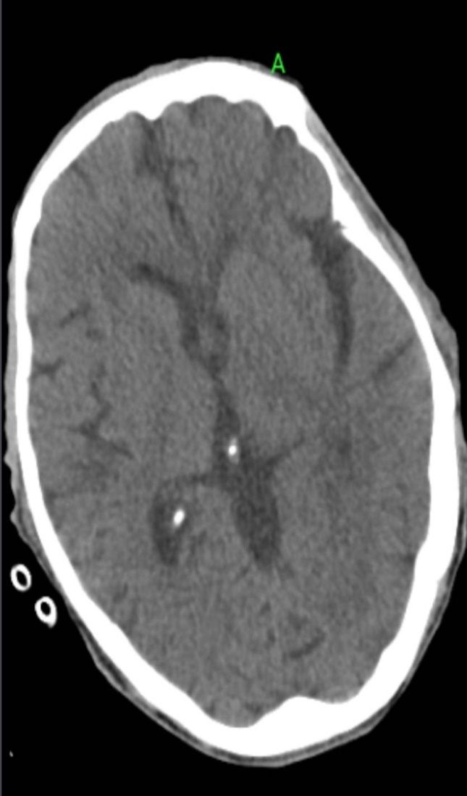
BRAIN CT

Slide 20
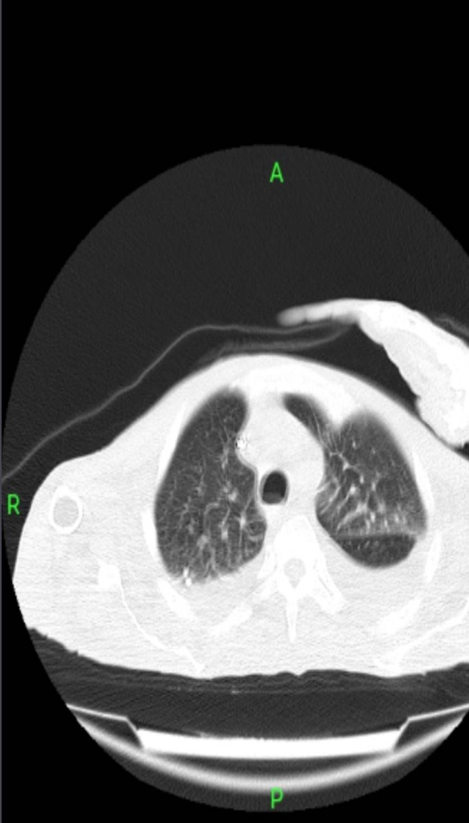
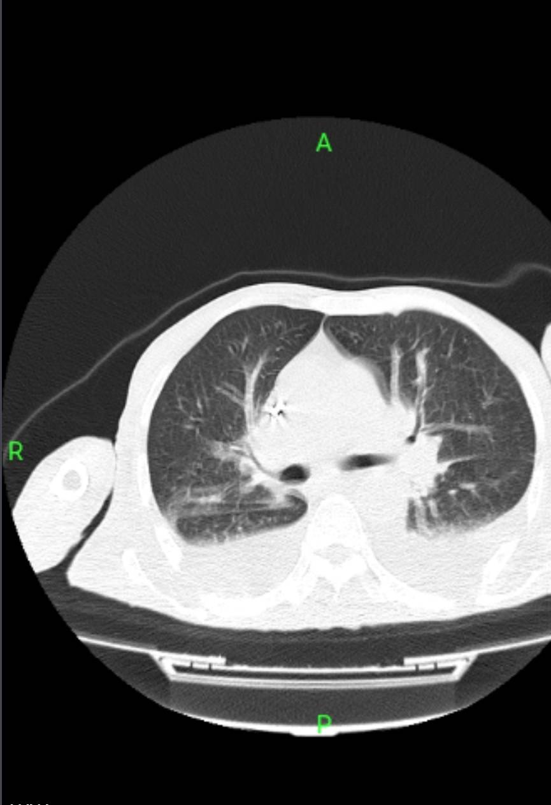
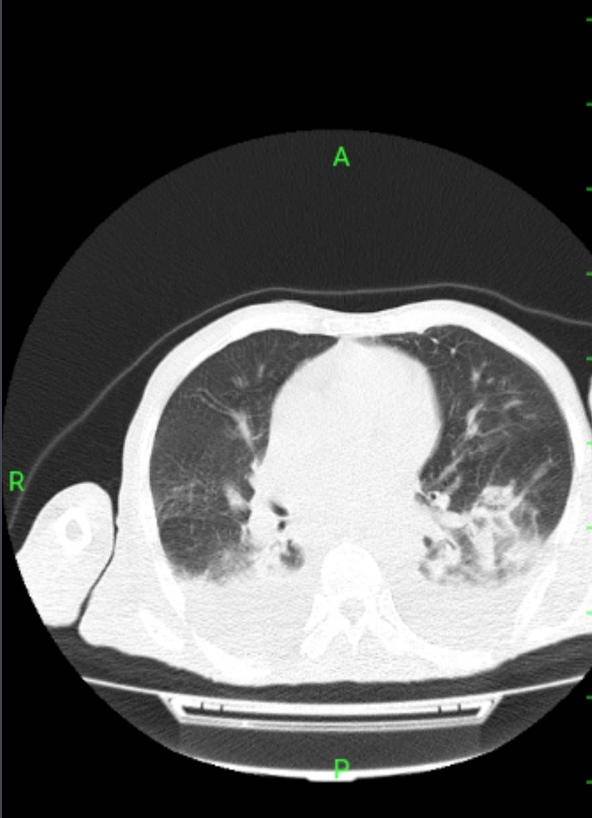
CHEST CT

Slide 21
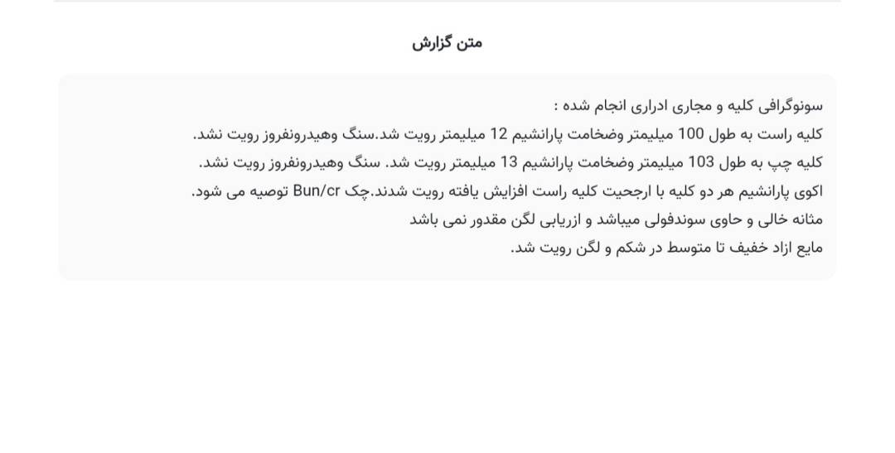

Slide 22
Step 3

Slide 23
The patient underwent diagnostic and therapeutic Thoracentesis. Pleural fluid analysis was consistent with a transudative effusion.
Gram stain, acid-fast smear, and microbiological cultures were negative.
An Abdominopelvic ultrasonography performed during the early days of hospitalization demonstrated mild-to-moderate free Intraperitoneal fluid.

Slide 24
Accordingly, diagnostic and therapeutic paracentesis was performed. Ascitic fluid analysis revealed a high serum–ascites albumin gradient (high-SAAG ascites).
Gram stain, acid-fast smear, and microbiological cultures were negative.

Slide 25
Autoimmune Work-up
ANA Negative
Anti-ds DNA Negative
C3 Low
C4 Lower limit of normal
CH50 Normal
C-ANCA Negative
P-ANCA Negative
Additional Laboratory Findings
NT- pro BNP 9,000 pg/mL
Lactate 10 mmol/L
Ferritin 1382 ng/mL
Serum Iron 40 µg/dL
TIBC 150 µg/dL
Total T4 Normal
B/C Klebsiella pneumoniae
Infectious Work-up
SARS-CoV-2 PCR Negative
Influenza PCR Negative
RSV PCR Negative
HIV Negative
HBs Ag Negative
Anti-HCV Negative
Fluid ADA 1.6

Slide 26
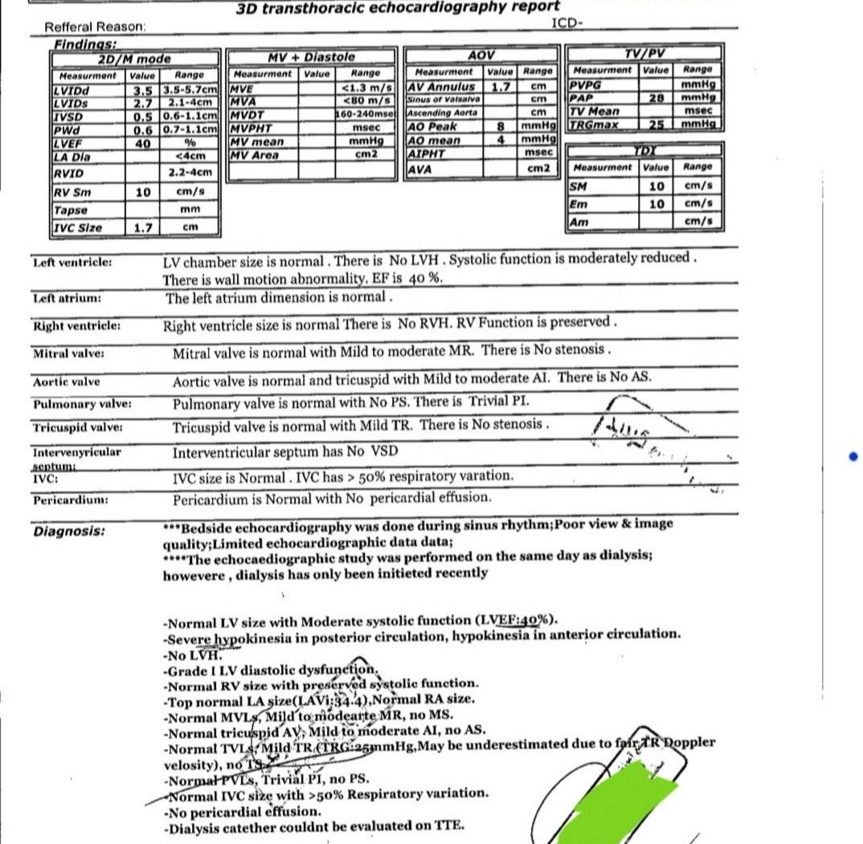

Slide 27
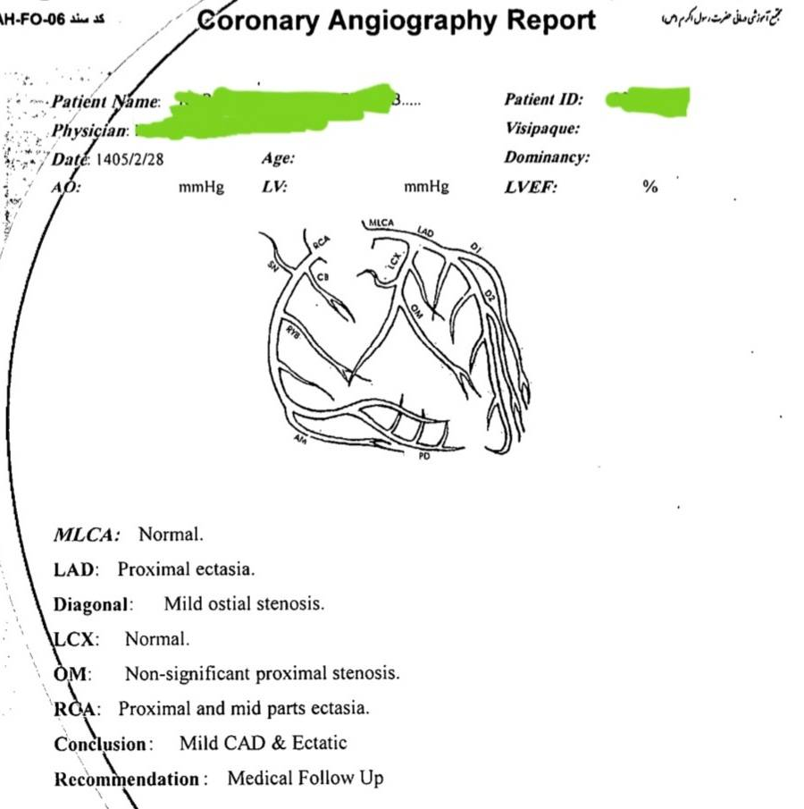

Slide 28
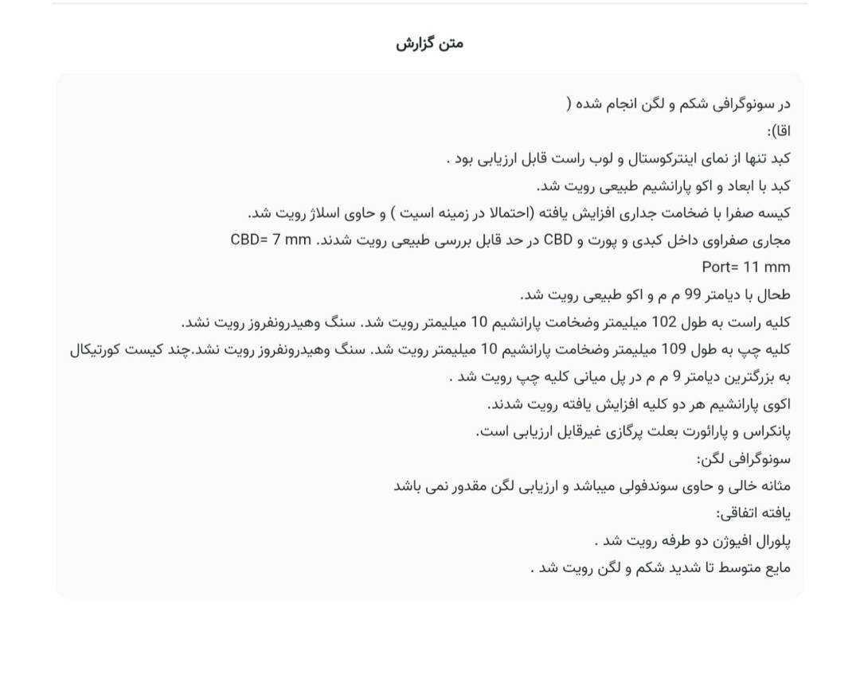

Slide 29
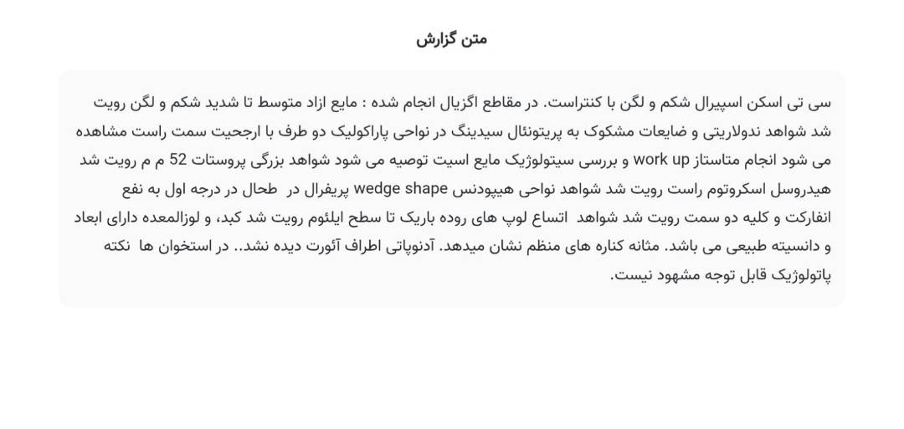

Slide 30
Step 4

Slide 31
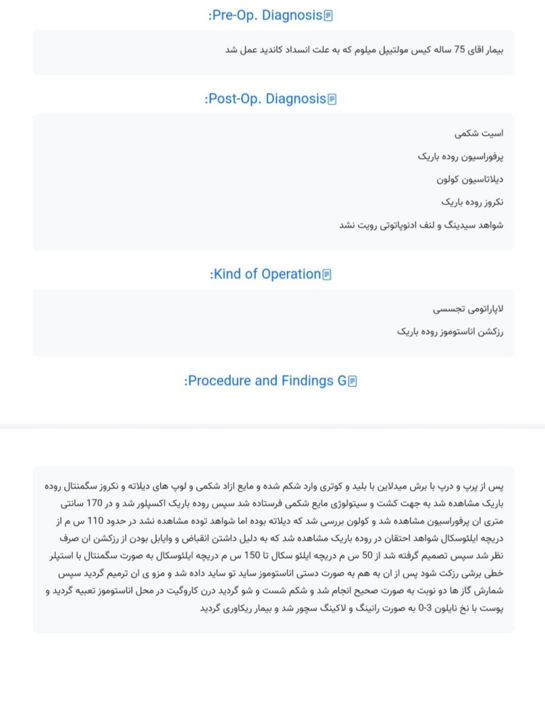

Slide 32
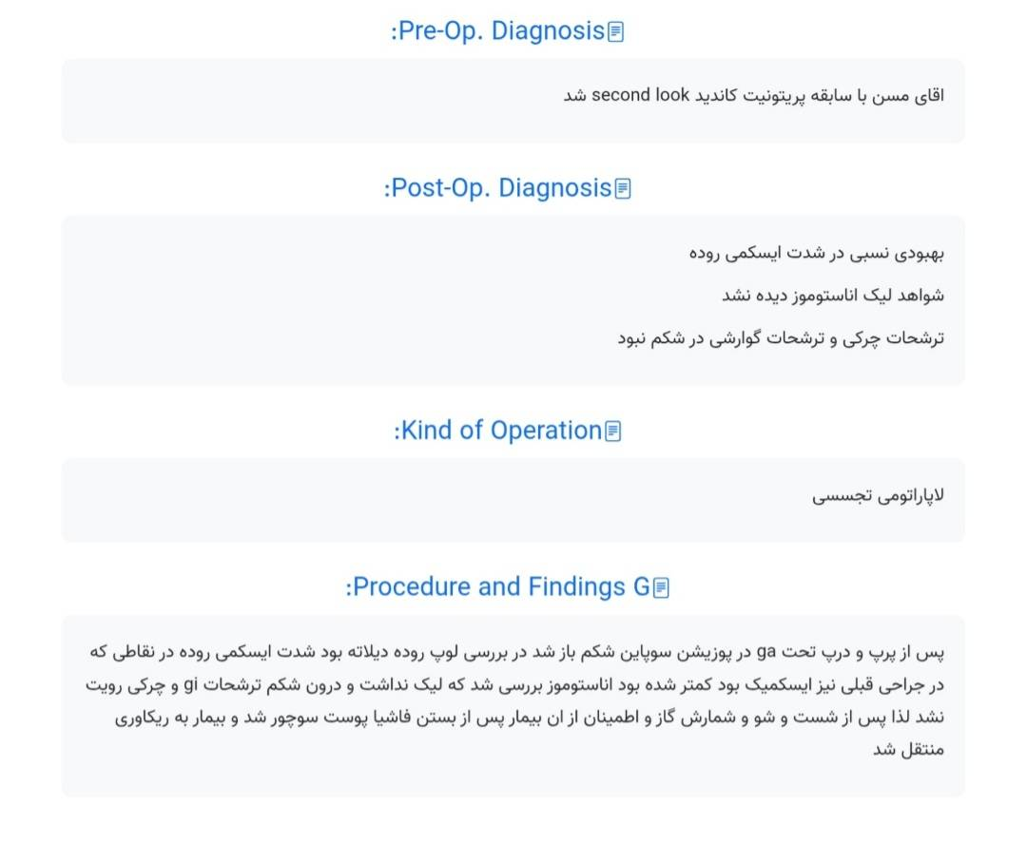

Slide 33
Hospital Course
The patient underwent multiple sessions of hemodialysis during hospitalization without significant clinical or laboratory improvement.
During the hospital course, he developed progressive abdominal pain, abdominal distension, and intolerance to oral intake.
Repeated General Surgery consultations were requested.
Abdominopelvic CT revealed findings consistent with small bowel ischemia, necrosis, and perforation.
The patient underwent exploratory laparotomy with small bowel resection, followed by a planned second-look laparotomy.
Postoperatively, he remained in the ICU, requiring TPN, multiple PRBC transfusions, and repeated hemodialysis. Electrolyte abnormalities were corrected during the ICU stay. Despite intensive supportive care, he developed recurrent deterioration of consciousness, required re-intubation and mechanical ventilation.

Slide 34
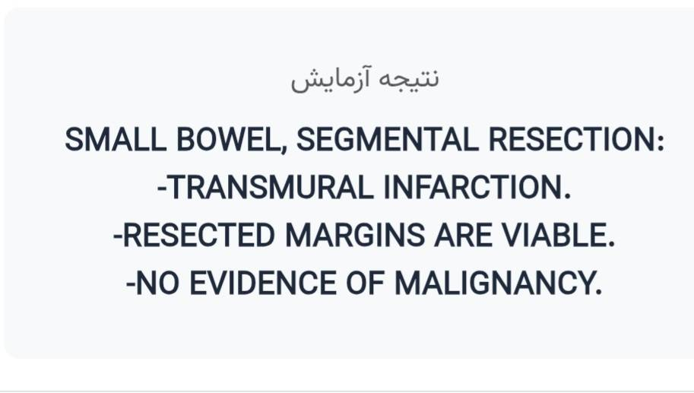
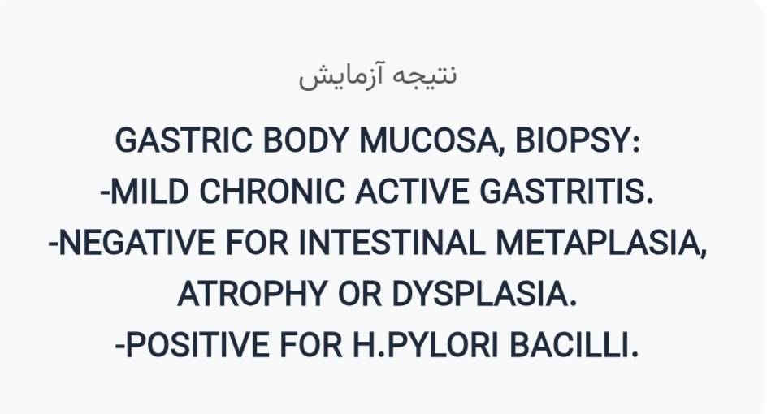
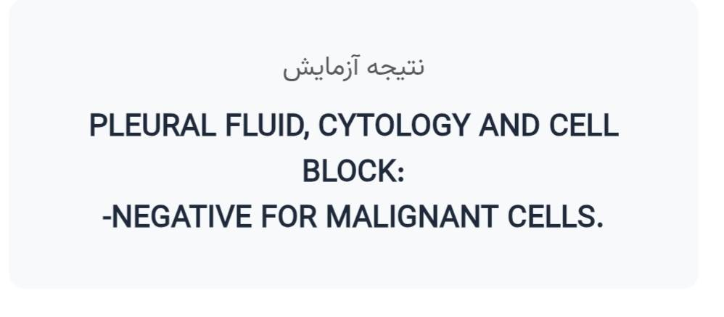
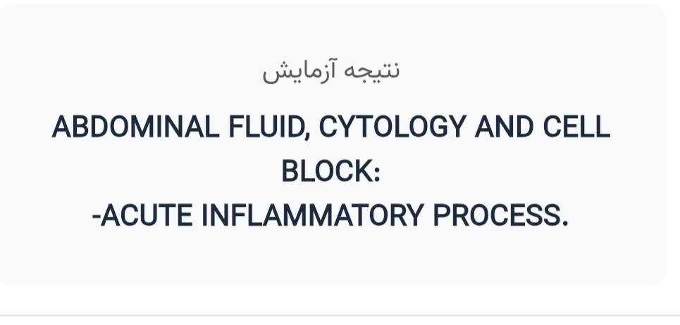
Pathology and cytology

Slide 35
FINAL DIAGNOSIS
Multiple systemic thrombosisis secondry to infection
(covid 19 –associated coagulopathy ??)

Slide 36
"Common diseases present uncommonly, and uncommon diseases may hide behind common symptoms."

